Slide 1




Reflections from Webinar 15: Stakeholders category needs for CSAM
AfricaMechanize Webinar 16
Second Webinar in Preparation for the Africa Conference on SAM (ACSAM)
Eng. Josef Kienzle
FAO Sustainable Mechanization Lead

Slide 2
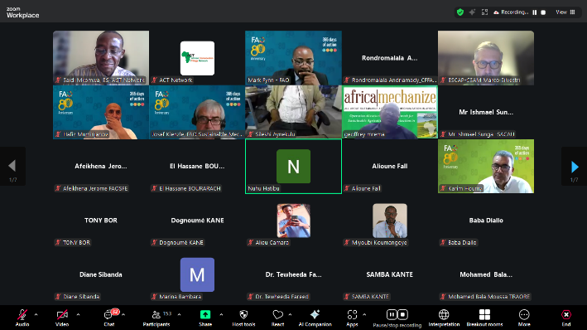
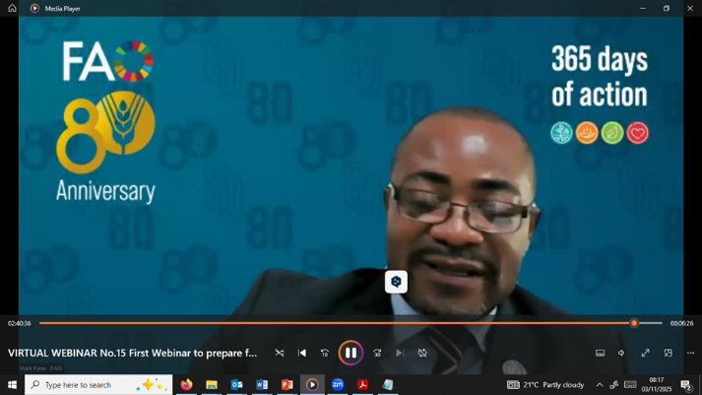
Webinar 15: First webinar in preparation for ACSAM

Slide 3
Introduction: Webinar 15
Virtually held on Thursday 23rd October 2025 in both English and French.
Attended by over 190 participants,
    Included: DAMES/HAMES, representatives from academia, non-governmental organizations, research institutes, the private sector, farmer organizations, farmers and development partners
The Objective:
    Create awareness about the objectives and intended outcomes of the upcoming Africa SAM Conference, and
    Provide a timely platform for exploring what an African CSAM(s) could entail.
Most importantly, stakeholders had the opportunity to articulate what such a Centre(s) would mean for them and what it must address.
Key presentations included: Operational Guidelines and Structures of the HAMES; Learning from the history of Africa’s SAM networks and Learning from Asia–Pacific CSAM

Slide 4
Stakeholders Needs for CSAM
Category 1: Researchers and academia
CSAM should:
Be an Open Research and Innovation Platform - for sharing designs, data, prototypes, and performance metrics of mechanization technologies that encourages co-creation, joint research, and crowdsourced problem-solving among African and global researchers;
Offer Standardization and Interoperability Platforms and Frameworks - to coordinate research
Support context-specific mechanization solutions - for diverse agro-ecologies and smallholder environments.
Capacity Building and Training - through targeted curricula, training modules, and internships on aspects that go beyond technical aspects to include business models.
Policy Research, Innovation Governance, and SAM advocacy by conducting interdisciplinary research
Support Cross-Learning and Benchmarking by building mechanisms for learning from other regions, - including Asia and Latin America, on successful cases.
Support Adoption and Testing of Mechanization Innovation Investment and Ownership Models
Position the Centre as “multi-sided innovation platform” -connecting Researchers/academia as knowledge producers; Fabricators/entrepreneurs as technology converters; Investors/donors as resource providers; and Farmers/ extension systems as end users following the Google model
Offer an Innovation Remittance and Buyout System - where researchers use the Centre’s resources to develop a prototype or design in exchange for a contractual remit of a portion of accrued licensing or commercialization revenues to the Centre until a threshold is reached, where ownership is then fully transferred to the researcher following the “rent-to-own” model.
Institute Research Impact Tokenization and Traceability by operationalization of such things as digital tokens or credits

Slide 5
Stakeholders Needs for CSAM cont’
Category 2: Farmers
Technology evaluation & adaptation: test, adapt, and certify machines for African agro-ecologies and cropping systems; promote modular, repairable designs.
Business models & market facilitation: incubate and train service providers, support aggregation/coops, and promote sustainable rental/contract farming models.
Financing instruments & risk sharing: design blended finance, guarantee funds, subsidy targeting (e.g., for service providers, not individual buyers), and insurance products tied to mechanization.
Skills & curriculum development: accredited training programs for operators, mechanics, technicians, and managers; mobile training units and e-learning.
Data, monitoring & knowledge sharing: build a regional database of mechanization demand, performance metrics, and best-practice case studies.
Sustainability & climate resilience: promote low-emission options, conservation agriculture-compatible implements (no-till planters), and energy-efficient machinery.
Gender, youth & inclusion programs: deliberate targeting, finance products for women/youth, and support for female service entrepreneurs.
Pilot & demonstration farms: live sites showing scalable packages by farm size and cropping system to de-risk adoption.

Slide 6
Stakeholders Needs for CSAM cont’
Category 3: Private Sector
Technology Innovation and Local Manufacturing: Accelerate testing, commercialization, and scaling of innovations.
Mechanization Services and Custom Hire Systems: Mechanization service centres can provide smallholder farmers with access to tractors, threshers, dryers, and other equipment through leasing or 'mechanization-as-a-service' (Maas) models supported by digital platforms.
Financing and Investment Partnerships: develop innovative financing solutions—to increase access to mechanization.
Standards and Quality Assurance: Regional standardization initiatives ensures product safety, reliability, and interoperability.
Capacity Building and Inclusion: Developing training and incubation programmes
Partnerships and Advocacy: Collaboration under public–private partnership (PPP) frameworks - ensure sustainable co-governance and long-term operational stability for the Africa CSAM initiative.

Slide 7
Stakeholders Needs for CSAM cont’
Category 4: NGOs and Media
Develop and share simplified SAM knowledge products (manuals, briefs, infographics).
Conduct capacity-building workshops for NGO field officers and journalists.
Maintain a digital SAM knowledge hub with data, visuals, and case studies accessible to non-technical audiences.
Establish information platform and develop media toolkits (press kits, visuals, radio scripts, social media content).
Facilitate partnerships between journalists, NGOs, and research institutions to ensure accuracy in reporting.
Create a Regional SAM Communication & Advocacy Network linking NGOs, media, and policy actors.
Develop simple MEL frameworks for communication and advocacy projects.
Support NGOs to carry out regional farmers profiling, segmentation, or categorization about SAM needs
Facilitate regional data exchange and innovative platforms documenting and amplifying impacts.
Establish an innovation and incubation centre for youths to innovate and develop their ideas
Provide media training on climate-smart mechanization and resilience reporting.
Create rapid communication toolkits for NGOs to integrate SAM into recovery projects.

Slide 8

Thank you for your attention

